Slide 1


Cost of Capital

Slide 2

Cost of Capital
For Investors the rate of return on a security is a benefit of investing.
For Financial Managers that same rate of return is a cost of raising funds that are needed to operate the firm.

Slide 3

How can the firm raise capital?
Bonds
Preferred Stock
Common Stock
Each of these offers a rate of return to investors.
This return is a cost to the firm.
“Cost of capital” actually refers to the weighted cost of capital - a weighted average cost of financing sources.

Slide 4
Cost of capital
K = r0 + b + f
r0 = normal rate of return
b = premium for business risk
f = premium for financial risk

Slide 5
Types of cost capital
Two types
1. Cost of individual sources of finance
Cost of debt (bonds or debentures)
Cost of preference shares
Cost of equity
2. Weighted average cost of capital

Slide 6

The Weighted Cost of Capital
To calculate the firm’s weighted cost of capital, we must first calculate the costs of the individual financing sources:
Cost of Debt
Cost of Preferred Stock
Cost of Common Stock

Slide 7

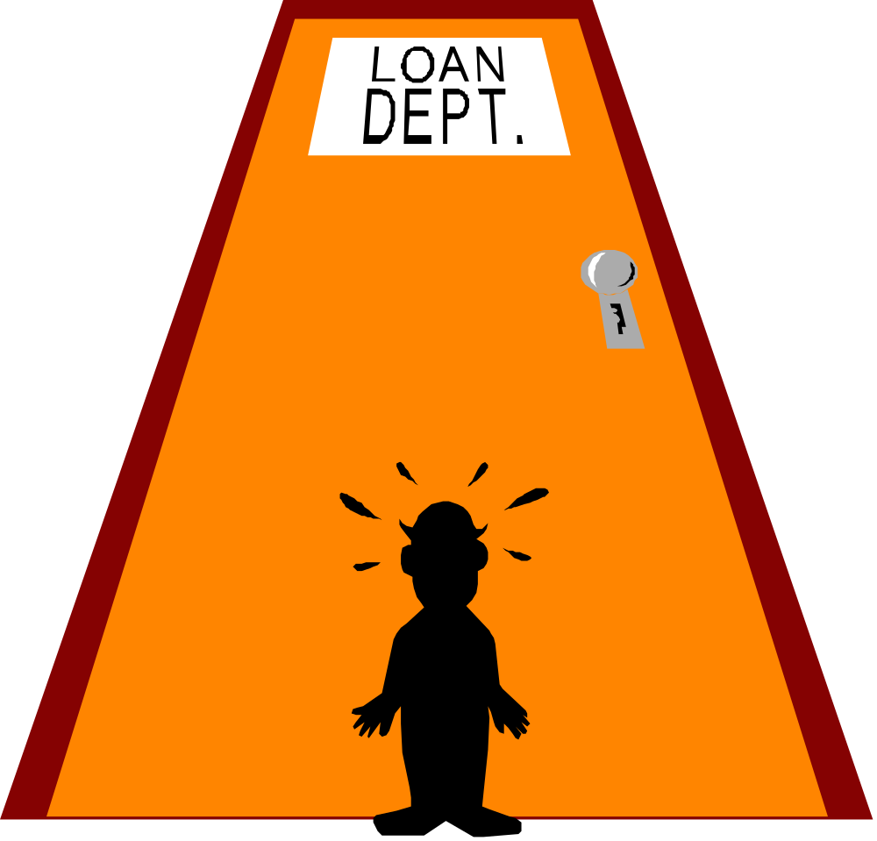
Cost of Debt

Slide 8

Cost of Debt
For the issuing firm, the cost of debt is:
the rate of return required by investors,
adjusted for flotation costs (any costs associated with issuing new bonds), and
adjusted for taxes.

Slide 9
Cost of Irredeemable Debt
kd = I/NP
Pretax Post tax
Kd= I/NP Kdt= I(1-t) /NP (or) kd (1-t)
Eg ;
12% debt of Rs 100/- each .50% tax .what is Kd?
Kd = 12/100 = 0.12 = 12%( interest rate = cost)
Kdt = 12(1-0.50)/100 = 0.06 = 6% ( cost will be less than interest rate)

Slide 10
15 % ,Debentures of Rs 100/- each for Rs 10,00,000/-,t=35%;
Issued at Par value
Issued at 10%Premium
Issued at 10%Discount
Find out kd before and after tax?

Slide 11
Cont….
(a)A company issues Rs.1,00,000,15%Debentures of Rs.100 each. The company is in 40% tax bracket. You are required to compute the cost of debt after tax, if debentures are issued at (i)Par, (ii)10% discount, and (iii)10% premium. (b)If brokerage is paid at 5%,what will be the cost of debentures if issue is at par?

Slide 12
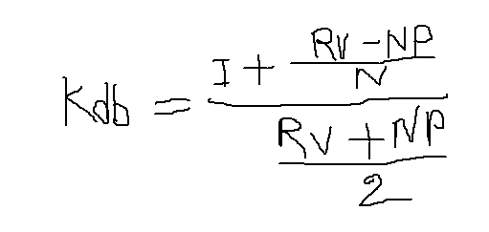
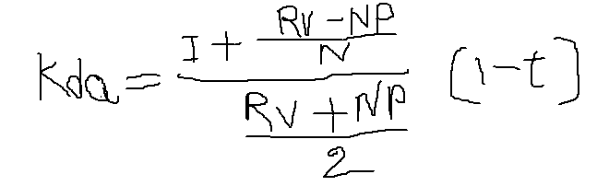
Cost of Redeemable Debt
Usually the debt is issued to be redeemed after a certain period during the lifetime of the firm. Such a debt issue is known as Redeemable Debt.
Where,
I = Interest
N = Number of years in which debt is to be redeemed
RV = Redeemable value of debt
NP = Net Proceeds

Slide 13
Cost of Redeemable Debt
XYZ Ltd. has issued 12% Debentures of face value of Rs.100 for Rs.60 lakh.The floating charge of the issue is 5% on face value. The interest is payable annually and the debentures are redeemable at a premium of 10% after10 years. What will be the cost of debentures if the tax is 50%?

Slide 14
Cost of redeemable debt
ABC company issues Rs100/- par value of debentures carrying 15% interest. The debentures are repayable after a period of 7 years at face value. The cost of issue is 3% and tax is 35%.What is Kd?

Slide 15

Example: Cost of Debt
Prescott Corporation issues a Rs1,000 par, 20 year bond paying the market rate of 10%. Coupons are annual. The bond will sell for par since it pays the market rate, but flotation costs amount to Rs50 per bond. Tax rate is 50%.
What is the pre-tax and after-tax cost of debt for Prescott Corporation?

Slide 16
Cont…..
X Ltd. issues Rs. 50,000 8% debenture. The tax rate applicable is 50%. Compute the cost of debt capital, if debentures are issued (i) at par (ii) at Premium of 10% (iii) at discount of 10%
A company issues Rs. 10, 00,000; 10% debentures at a discount of 5%. The cost of floatation amounts to Rs. 30,000. The debentures are redeemable after 5 years. Calculate before tax and after tax cost of debt assuming a tax rate of 50%.

Slide 17

Cost of Preferred Stock
It is the shares, which have preferential right to get dividend and get back the initial investment at the time of winding up of the company.
Preference shareholders are eligible to get fixed rate of dividend and
they do not have voting rights.

Slide 18
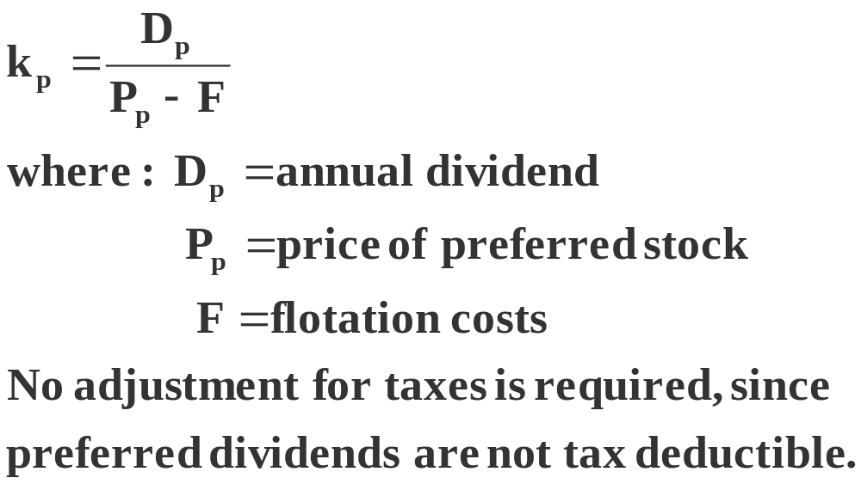
Cost of Preference Shares (Continued)
Cost of Preferred Stock (k_{p}) (perpetual):

Slide 19

Example: Cost of Preferred
If A Corporation issues preferred stock, it will pay a dividend of Rs8 per year and should be valued at Rs75 per share. If flotation costs amount to Rs1 per share, what is the cost of preferred stock for Prescott?

Slide 20

Cost of Preferred Stock
D
NPo
Dividend
Net Proceeds
kp = =

Slide 21
Cost of Preferred Stock
D
NPo
Dividend
Net Price
kp = =
= = 10.81%
8.00
74.00

Slide 22
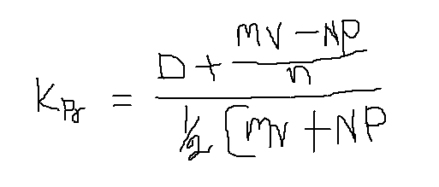
Cost of Redeemable preference shares
Kpr = Cost of Redeemable Preference Shares
D = Annual Preference Dividend
MV – Maturity Value
NP = Net Proceeds

Slide 23
1. A Company issues 10,000 10 % preference shares of Rs. 100 each. Cost of issue is Rs. 2 per share. Calculate cost of preference capital, if the shares are issued
i) At par
Ii) At a premium of 10 % and
Iii) At a discount of 5 %
2. A Company issues 10,000 10 % preference shares of Rs. 100 each redeemable after 10 years at a premium of 5 %. The cost of issue is Rs. 2 per share. Calculate the cost of preference capital.
3. A Company issues 1000 7 % preference shares of Rs. 100 each redeemable after 5 years at par. Calculate the cost of preference capital.

Slide 24

Cost of Equity
The cost of equity is the maximum rate of return the company must earn on equity financed
It may or may not be paid
It does not mean that, equity is a cost free capital

Slide 25

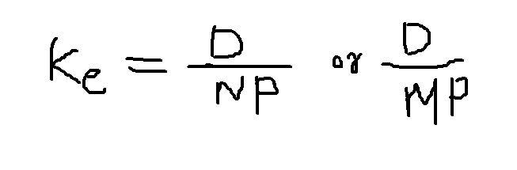
Cost of Equity
Dividend yield method
A company issues 1000 equity shares of Rs. 100 each at a premium of 10 %. It is paying 20 % dividend for the past 5 years and expected to pay the same in future also. Compute the cost of equity capital. Will it make any difference if the market price of equity is Rs. 160?

Slide 26
Cost of Equity
2) Dividend Growth Model
Kc = + G or
Kc = + G
D1 = Expected dividend at the end of year
D1
NP
D0 (1+g)
NP

Slide 27
Cont…..
1). A Company plans to issue 1000 new shares of Rs. 100 each at par. The flotation costa are expected to 5% of the share price. The company pays a dividend of Rs. 10 per share initially and the growth in dividends is expected to be 5 % . Compute the cost of new issue of equity shares.
If the current market price of equity is Rs. 150 calculate the cost of existing equity share capital.
2). The shares of the company are selling at rs. 40 per share and it had a dividend of Rs. 4 per share last year. The investor’s market expected growth rate 5 % per year. Calculate the cost of equity.
If the anticipated growth rate is 7 % per annum indicate market price per share.

Slide 28
Cost of Equity
3) Capital Asset Pricing Model (CAPM)
ER_{i​}=R_{f​}+β_{i}​(ER_{m}​−R_{f​})
where:
ERi​=expected return of investment
Rf​=risk -free rate
βi​=beta of the investment
(ERm​−Rf​)=market risk premium​

Slide 29
CONT…..
Risk-Free Rate (rf) = 3.0%
Beta (β) = 0.8
Expected Market Return (rm) = 10.0%
Cost of Equity (Ke) = 3% + 0.8 (7.0%) = 8.6%

Slide 30
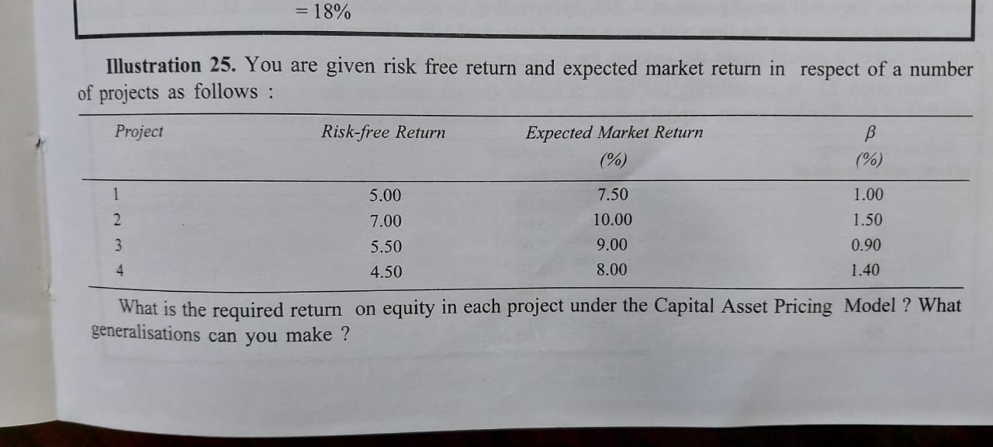

Slide 31
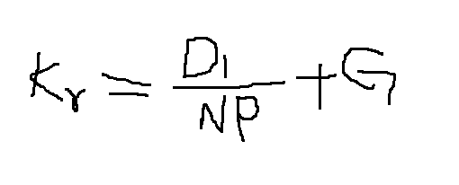
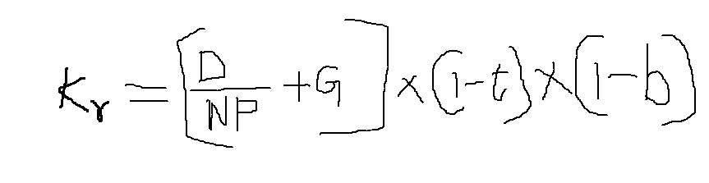
Cost of Retained earnings
To make adjustment in the cost of retained earnings for tax and costs of purchasing new securities, the following formula may be adopted.
b= cost of purchasing new securities or brokerage costs

Slide 32
A Firms Ke is 15 % the average tax rate of shareholders is 40 % and it is expected that 2 % is brokerage cost that share holders will have to pay while investing their dividends in alternative securities. What is the cost of retained earnings?
Kr = 15% (1-0.4) (1-0.02)
Kr = 8.82%

Slide 33

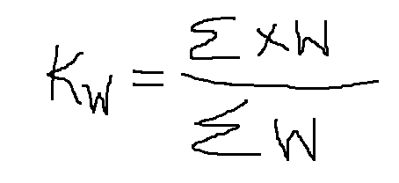
Weighted Cost of Capital
The weighted cost of capital is just the weighted average cost of all of the financing sources.
Kw = weighted average cost of capital
X = cost of specific source of finance
W = Weight .

Slide 34


Weighted Cost of Capital
Capital
Source Cost Structure
debt 6% 20%
preferred 10% 10%
common 16% 70%

Slide 35

Weighted Cost of Capital
(20% debt, 10% preferred, 70% common)
Weighted cost of capital =
.20 (6%) + .10 (10%) + .70 (16)
= 13.4%

Slide 36
